Slide 1


Tourism Industry Performance Dashboard: Consolidated Reporting

Slide 2
Consolidated Reporting for MATI Members
This presentation provides a comprehensive summary of the different types of data commonly used within the tourism industry, with a special focus on the MATI Member Portal and Statistical Snapshots. It demonstrates how these data resources support informed business decisions and strategic planning, while also identifying existing data gaps that need to be addressed

Slide 3
1. MATI Member Portal Overview
What is the MATI Member Portal?
The MATI Member Portal is a one-stop resource centre for Maldives Tourism related statistics. This exclusive platform serves as a comprehensive data hub designed specifically for MATI members to access, analyze, and leverage tourism industry information.
Key Features:
Historical Data Coverage: Comprehensive datasets from 2017 onwards
Customized Comparisons: Create tailored analysis based on specific business needs
Exclusive Access: Available only to MATI Members

Slide 4
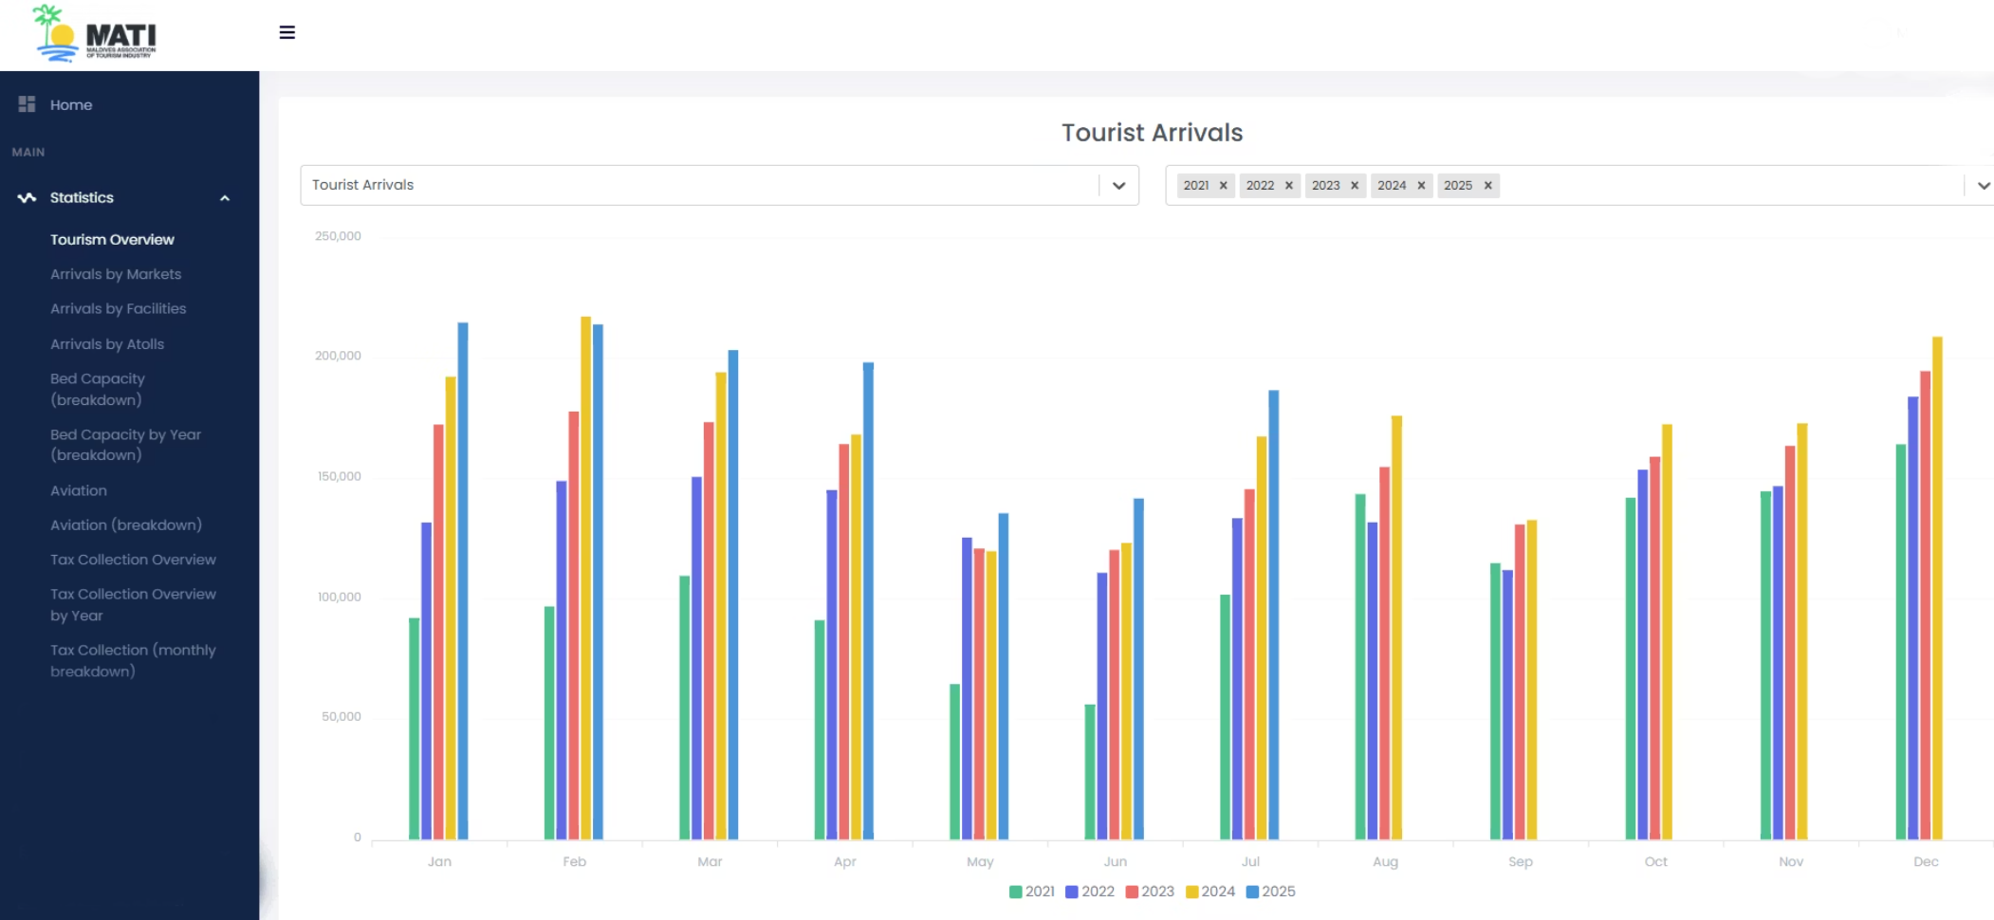
2. Data Categories in MATI Member Portal
Tourist Arrivals Data
Data Types Available:
Monthly arrival numbers
Year-over-year comparisons
Seasonal patterns and trends
Growth rate analysis
Historical comparisons (2019 onwards)

Slide 5
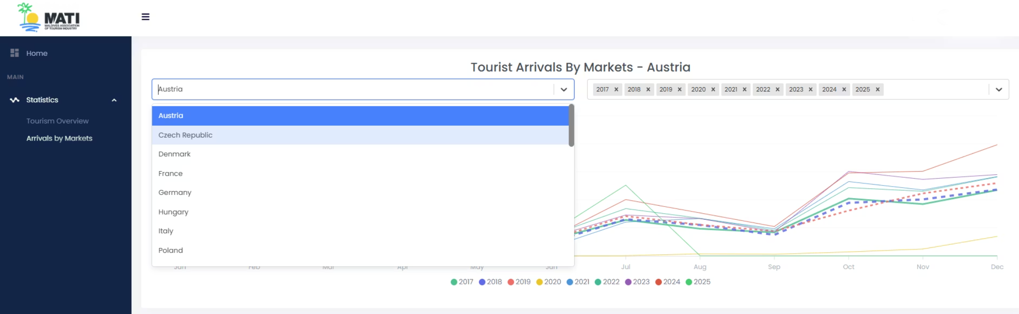
Market Analysis Data
Data Types Available:
Arrival numbers from 30+ key source markets
Market share analysis
Country-wise growth rates
Emerging market identification

Slide 6
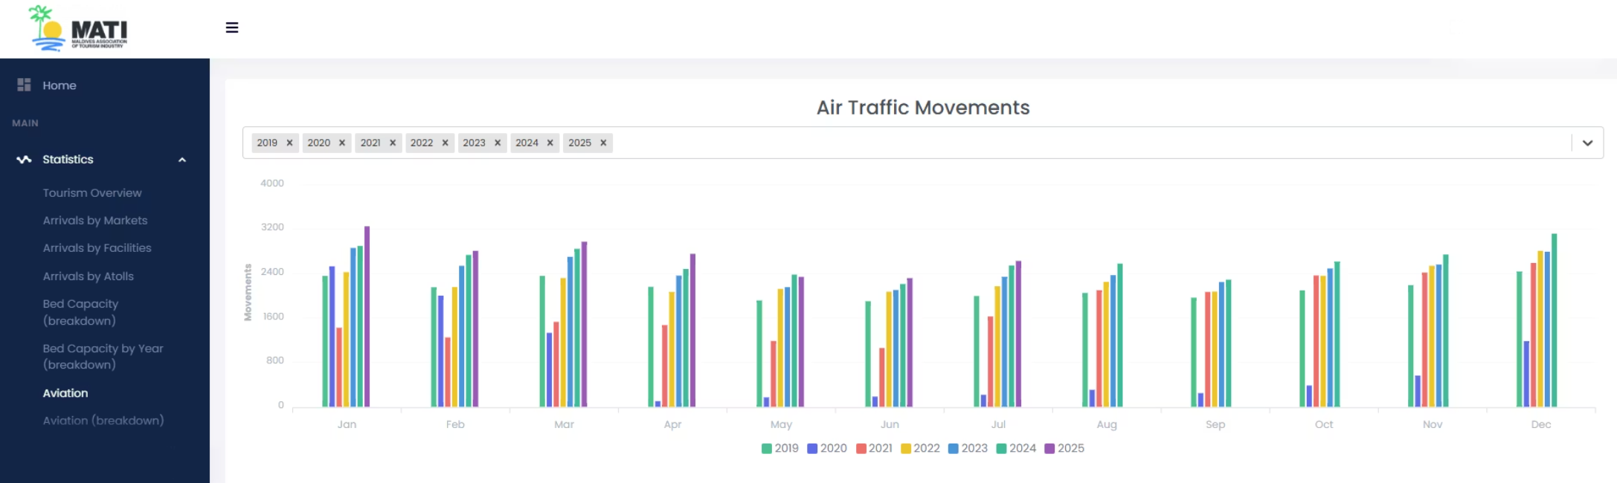
International Flight Movements
Data Types Available:
Total flight arrivals and departures
Flight movements
Airline-wise performance metrics

Slide 7
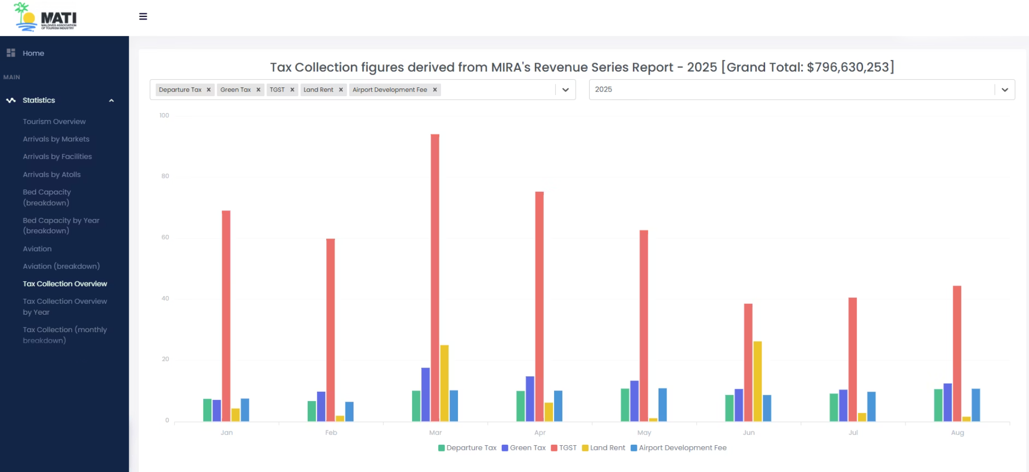
Tourism Tax Collections
Data Types Available:
Tourism Goods and Services Tax (TGST) collections
Green Tax revenue
Airport Development Fee collections
Departure Tax data
Business Permit and Registration fees
Tourism Land Rent collections
Monthly and annual tax comparisons

Slide 8
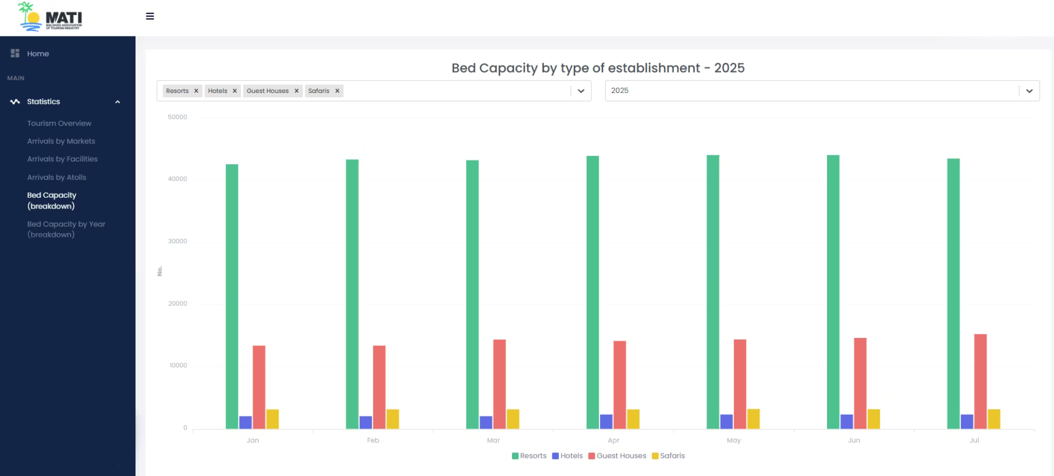
Bed Capacity Analysis
Data Types Available:
Total bed capacity by accommodation type (Resorts, Hotels, Guesthouses, Vessels)
Occupancy rates and patterns
Capacity utilization metrics
Geographic distribution of beds by atoll

Slide 9

3. Statistical Snapshot Components
Monthly Performance Metrics
The Statistical Snapshot provides a comprehensive monthly overview including:
Tourist Arrivals: Current month performance, year-over-year changes, cumulative annual figures
Market Performance: Top 10 source markets for the month and year-to-date
Historical Comparisons: 5-year trend analysis for key metrics
Growth Indicators: Percentage changes and growth rates across all metrics

Slide 10
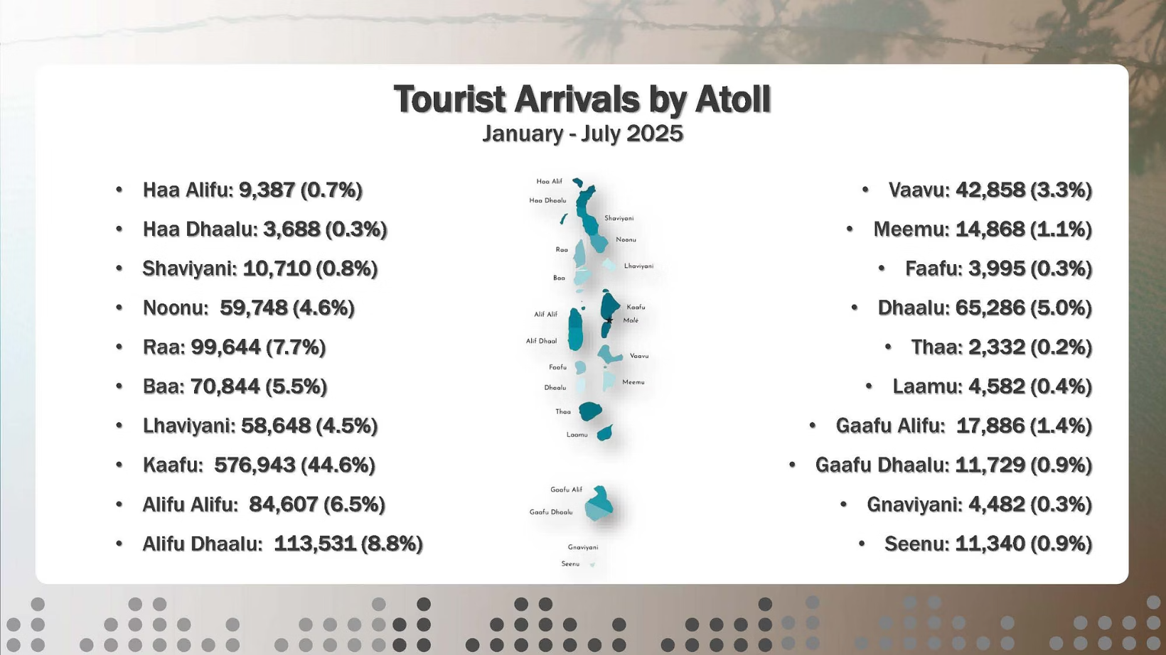
Geographic Distribution Data
Detailed breakdown of tourism activity by location:
Tourist arrivals by atoll (monthly and cumulative)
Percentage distribution across 20 atolls
Operational establishments by atoll
Bed capacity by atoll and accommodation type
Regional concentration analysis

Slide 11
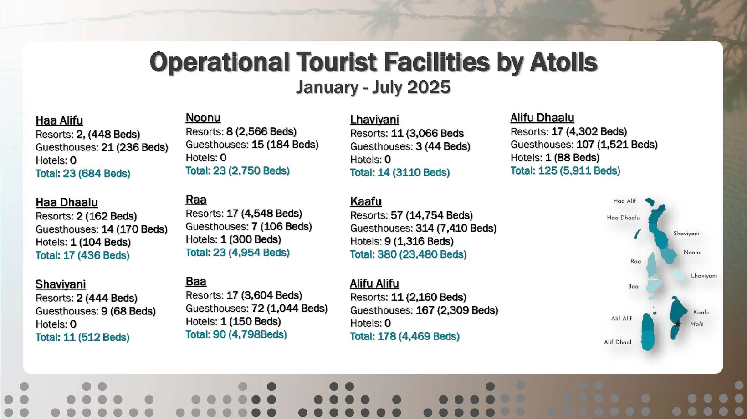
Accommodation Sector Analysis
Comprehensive data on tourism facilities:
Operational Establishments: Current count of resorts, hotels, guesthouses, and tourist vessels
Arrival Distribution: Percentage of tourists by accommodation type
Capacity Metrics: Total beds available by category
Development Pipeline: Ongoing developments and future capacity
Year-over-year facility comparisons

Slide 12
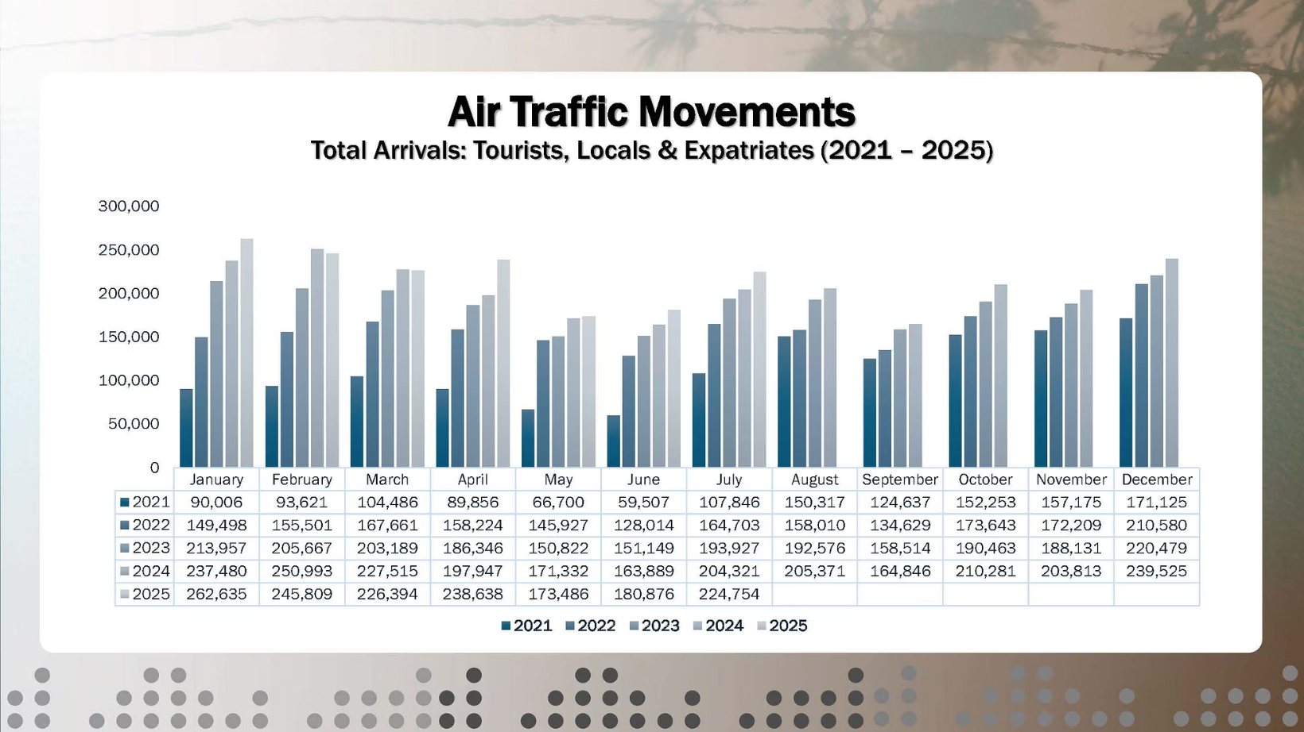
Aviation and Connectivity Metrics
Comprehensive air traffic and airline performance data:
Total arrivals including tourists, locals, and expatriates
Aviation load factor analysis: Total seat capacity vs. actual arrivals
Top 10 airlines by passenger volume
Monthly and annual traffic patterns

Slide 13

5. How Data Can Supports Business Decisions
Strategic Planning Applications
Market Development: Identify growing source markets and adjust marketing strategies
Capacity Planning: Leverage occupancy data to optimize room inventory and pricing
Revenue Management: Leverage seasonal patterns for dynamic pricing strategies
Investment Decisions: Analyze atoll-wise performance for expansion planning
Competitive Benchmarking: Compare performance against industry averages

Slide 14

Operational Applications
Staff Planning: Use arrival forecasts for workforce scheduling
Marketing Budget Allocation: Focus resources on high-performing markets
Partnership Development: Identify key airlines and tour operators
Service Enhancement: Tailor offerings based on market preferences
Risk Management: Diversify based on market concentration data

Slide 15

6. Identifying and Addressing Data Gaps
Missing Data Categories
Guest Experience Metrics: Satisfaction scores, reviews, and feedback analysis
Visitor Behavior Data: Length of stay by market, repeat visitor rates
Spending Patterns: Average daily spend, expenditure categories, payment methods
Digital Engagement: Online booking patterns, digital marketing effectiveness
Sustainability Indicators: Environmental impact, carbon footprint, resource consumption
Employment Statistics: Tourism workforce data, training metrics, skill gaps

Slide 16

Data Enhancement Opportunities
Real-time Updates: Move from monthly to daily or weekly data updates
Economic Impact
Predictive Analytics: Advanced forecasting models and scenario planning
Predictive Analytics
Competitor Intelligence: Regional destination comparisons
Guest Journey Mapping: End-to-end visitor experience tracking
Real-time Updates
Competitor Intelligence
Economic Impact Analysis: Broader economic contribution metrics
Guest Journey Mapping
Crisis Response Data: Real-time monitoring for rapid response

Slide 17

8. Conclusion
Key Takeaways
The MATI Member Portal provides comprehensive tourism data from 2019 onwards
Statistical Snapshots offer monthly performance summaries with detailed metrics
Data categories span arrivals, markets, aviation, tax, and capacity metrics
These resources enable data-driven decision making for strategic and operational planning
Identified data gaps present opportunities for future enhancement
Portal access is exclusive to MATI members, ensuring competitive advantage

